Slide 1
Introduction to Hadoop
Authored by :Shalaj Shukla Presented by :Shalaj Shukla

Slide 2
Agenda
What is Big Data
Big Data Challenges
History

Slide 3
What is Big Data
Big Data is a collection of large datasets that cannot be processed using traditional computing techniques.
Data that would take too much time and cost too much money to load into a relational database for analysis
Big data doesn’t refer to specific quantity, the term is often used when speaking about terabytes ,petabytes and exabytes of data
Notes:
Data that is beyond to storage capacity and beyond to the processing power

Slide 4
What Comes under Big Data
Social Media Data
CCTV Data
Stock Exchange Data
Search Engine Data
Sensors Data
Online Shopping Data
And many more
Notes:
90% of the world’s data was generated in the last few years

Slide 5
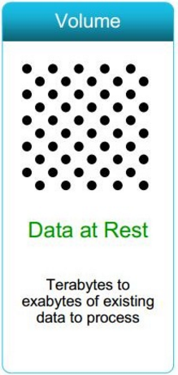
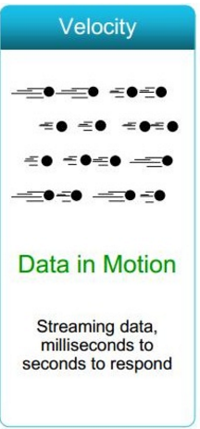
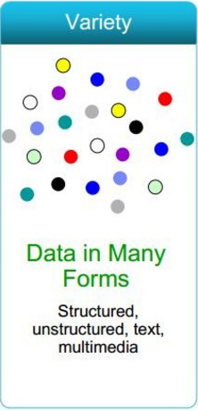
Big Data Characteristics (3 Vs)
Notes:
Volume: Data Quantity-Data is rapidly increasing
Velocity: Data speed -Sometimes 2 minutes is too late. For time critical applications where Time is the core factor such that catching the frauds, catching the hackers, running status of train, big data must be used as it streams into your enterprise in order to maximize its value. Not only is the volume of data large, it is arriving ever more rapidly. Example: Scrutinize 5 million trade events created each day to identify potential fraud Analyze 500 million daily call detail records in real-time to predict customer churn faster "machine data" generated on the factory floor or trading data generated by financial markets.
Variety: Data Types -Big data includes both structured and unstructured data such as text, sensor data, audio, video, click streams, log files and more. New insights are found when analyzing these data types together. Example: Monitor 100's of live video feeds from surveillance cameras to target points of interest Exploit the 80% data growth in images, video and documents to improve customer satisfaction.

Slide 6
Big Data Challenges
How To Store Big Data
How to store big data beyond capacity of disk space
How To Process Big Data
How to Process big data with reasonable cost and time?
Notes:
Storage – In Traditional approach data were store under RDBMS or data warehouses managed by Data Centers under high reliable systems
Processing – Fetch data from Data Centers and apply client program to process the data

Slide 7
History
Google
2003
Published white paper on Google File System – Distributed File System
2004
Published white paper on Map Reduce –
Distributed Processing

Slide 8




Hadoop Developers
2005: Using the solution provided by Google ,Doug Cutting and Michael J. Cafarella developed an open source project Hadoop
The project was funded by Yahoo.
2006: Yahoo gave the project to Apache
Software Foundation.
Doug Cutting
Distributed file system – GFS
Distributed Processing– Map Reduce

Slide 9
Hadoop Core Component
Hadoop Distributed File System
HDFS is a file system designed for storing very large files with streaming data access patterns, running on clusters of commodity hardware.
Map Reduce
MapReduce is a Distributed Data Processing or Batch Processing Programming Model. Like HDFS, MapReduce component also uses Commodity Hardware to process “High Volume of Variety of Data at High Velocity Rate” in a reliable and fault-tolerant manner.
Hadoop has a master/slave architecture both storage and processing

Slide 10
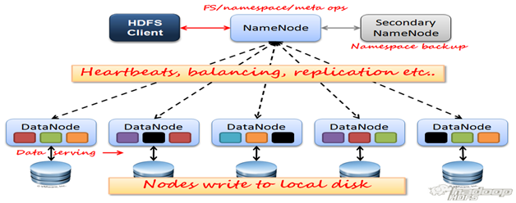
HDFS 1.x Architecture

Slide 11
HDFS – Master Services
Name Node:
Stores metadata for the files, like the directory structure , permission, ownership, last modified time etc.
The server holding the NameNode instance is quite crucial, as it is Single point of Failure.
Handles creation of more replica blocks when necessary after a Data Node failure
Secondary Name Node:
One misinterpretation from name is “This is a backup Name Node” but IT IS NOT!!!!!
SNN is responsible for performing periodic checkpoints. So in the event of Name node failure, we can restart name node using the check point
Notes:
SNN - It manages the metadata for the Name Node. In the sense, it reads the information written in edit logs (by Name Node) and creates an updated file of current cluster

Slide 12
HDFS – Slave Service
Data Node:
There are many instances of this process running on various slave nodes(referred as Data nodes)
It is responsible for storing the individual file blocks on the slave nodes in Hadoop cluster
Based on the replication factor, a single block is replicated in multiple slave nodes to prevent the data loss
This process periodically sends heart beat to Name Node to make Name Node aware that slave process is running
Send block reports to Name Node.

Slide 13
HDFS Configuration files
core-site.xml
Name Node address (fs.defaultFS )
hdfs-site.xml
Block size (dfs.blocksize)
Replication factor (dfs.replication)
Name node directory (dfs.namenode.name.dir)
Data node directory (dfs.datanode.data.dir)

Slide 14
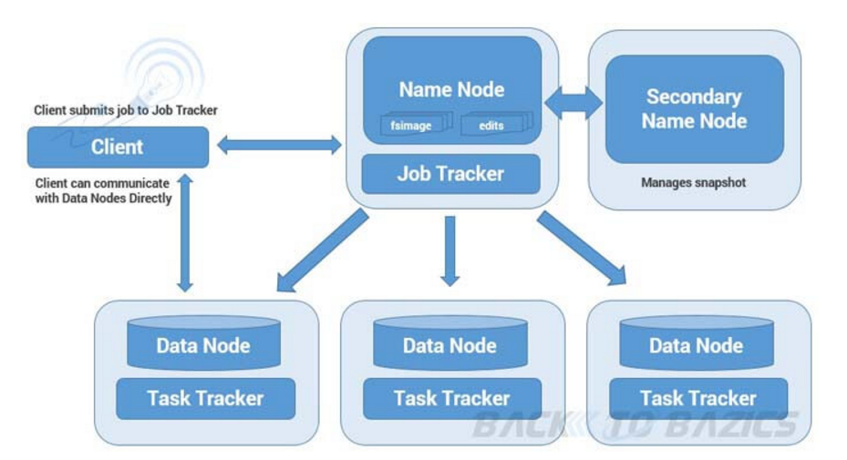
Map Reduce Architecture

Slide 15
Map Reduce – Master Service
Job Tracker:
Only one instance of this process runs on a master node same as Name Node
Any MapReduce job is submitted to Job Tracker first
Job Tracker checks for the location various file blocks used in MapReduce processing
Than it initiates the separate tasks on various Data Nodes(where blocks are present) by communicating with Task Tracker Daemons
It does resource management, job management and log management

Slide 16
Map Reduce – Slave Service
Task Tracker:
This process has multiple instances running on the slave nodes
It receives the job information from Job Tracker daemon and initiates a task on that slave node
They are responsible for running the map and reduce tasks as instructed by Job tracker
In most of the cases, Task Tracker initiates the task on the same node where there physical data block is present
Same as Data Node daemon, this process also periodically sends heart bits to Job Tracker to make Job Tracker aware that slave process is running

Slide 17
Mapreduce Configuration file
Mapred-site.xml
mapred.job.tracker
mapred.job.tracker.http.address
mapred.tasktracker.map.tasks.maximum
mapred.tasktracker.reduce.tasks.maximum
Notes:
mapred.job.tracker -- <ip_address>:8021 -- Job Tracker ip address and port number
mapred.job.tracker.http.address -- <ip_address>:50030 -- Job tracker web UI ip address and port number
mapred.tasktracker.map.tasks.maximum -- Maximum Map slots per task tracker
mapred.tasktracker.reduce.tasks.maximum -- Maximum Reduce slots per task tracker

Slide 18
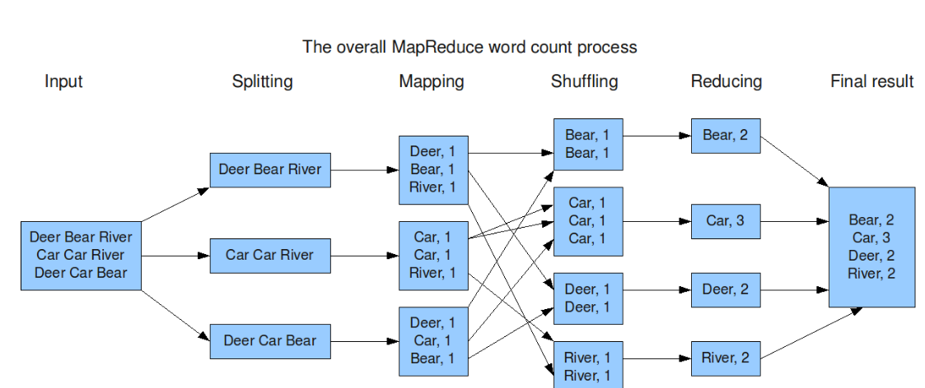
Map Reduce Word Count

Slide 19
Hadoop 1.x Limitations
Major drawback of Hadoop 1.x Architecture is Single Point of Failure as there is no backup Name Node.
Job scheduling, resource management and job monitoring are being done by single Job Tracker.
Under utilization of resources as mappers and reducers are pre-configured
Tightly coupled with Map reduce job

Slide 20
Hadoop 2.x Architecture
TBD

Slide 21
YARN Architecture
TBD

Slide 22
MR1 Vs MR2
Slaves (Datanodes and Tasktrackers)
Hadoop Cluster – Processing (MRv1/Classic)
Two data sets
One with 2 files/blocks
Another with 4 files/blocks
m
Gateway
Job Tracker
r
1
m
Request have gone to job tracker
Job submitted and monitored
Job is submitted to process the data
2 map tasks are created where data is stored (data locality)
Map tasks are created to read data from HDFS and perform row level transformations
1 reduce task is created to aggregate the data

Slide 23
MR1Vs MR2
Slaves (Datanodes and Tasktrackers)
m
Hadoop Cluster – Processing (MRv1/Classic)
m
Gateway
r
m
1
2
m
Job tracker will perform both resource management and monitors job management of all jobs
m
One job is running
Second job is submitted
r
m

Slide 24
MR1Vs MR2
Slaves (Datanodes and nodemanagers)
Hadoop Cluster – Processing (MRv2 + YARN)
Two data sets
One with 2 files/blocks
Another with 4 files/blocks
m
Gateway
Resource Manager
r
1
m
Job is submitted to process the data
Request have gone to resource manager
First application master will be created
Application master will determine which nodes map and reduce tasks should be executed in “containers”
Application master will take care of job management (unlike classic where job tracker does job management)
a

Slide 25
MR1Vs MR2
Slaves (Datanodes and nodemanagers)
a
m
Hadoop Cluster – Processing (MRv2 + YARN)
Two data sets
One with 2 files/blocks
Another with 4 files/blocks
m
Gateway
Resource Manager
r
m
1
2
r
m
m
One job is running
a
m

Slide 26
Hadoop Distributions
Hadoop
Hive
Monitoring
Sqoop
Many more
Hortonworks
Cloudera
MapR
HDInsight

Slide 27
Any Questions?

Slide 28
Thank you!

